Slide 1
ARIA 2024-2025: Co-medication and as-needed medication
Bernardo Sousa Pinto
(bernardo@med.up.pt)
2025 Dec, 8-11

Slide 2
Introduction
ARIA 2024-2025 guidelines: Person-centred, evidence-based, digitally-enabled, artificial intelligence enabled guidelines;
Development of guideline questions for ARIA 2024-2025;
  Use of large language models to support the generation of guideline questions.
Use of multiple sources of evidence in ARIA 2024-2025.

Slide 3
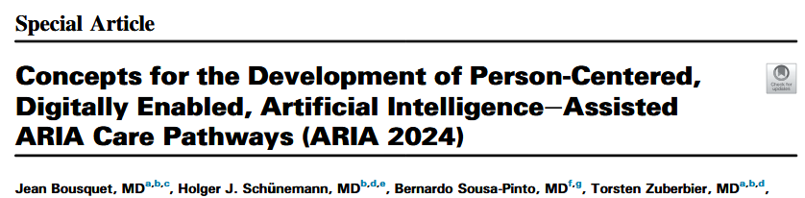
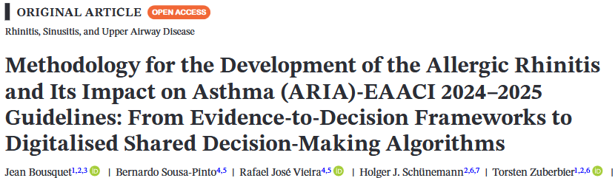
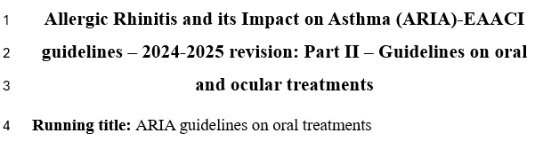
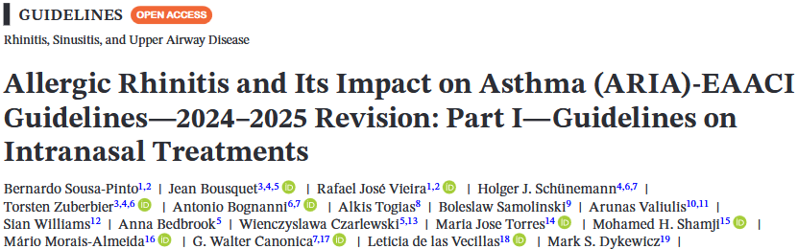
ARIA 2024-2025 guidelines so far
To be submitted
Next guidelines

Slide 4
Next guidelines: Co-medication and as-needed strategies
Should a combination of an oral H1-antihistamine and intranasal glucocorticosteroid vs. an intranasal glucocorticosteroid alone be used for the treatment of allergic rhinitis?
Should a combination of an oral H1-antihistamine and an intranasal glucocorticosteroid vs. an oral H1-antihistamine alone be used for the treatment of patients with allergic rhinitis?
Should co-medication vs. medication up-dosing be used in patients with allergic rhinitis which is poorly-controlled despite pharmacological treatment?
Should continuous long-term/chronic treatment vs. as-needed treatment be used in patients with allergic rhinitis?

Slide 5
2. Should co-medication vs. medication up-dosing be used in patients with allergic rhinitis which is poorly-controlled despite pharmacological treatment?
ARIA 2024-2025 guidelines: Person-centred, evidence-based, digitally-enabled, artificial intelligence enabled guidelines;
Development of guideline questions for ARIA 2024-2025;
  Use of large language models to support the generation of guideline questions.
Use of multiple sources of evidence in ARIA 2024-2025.

Slide 6
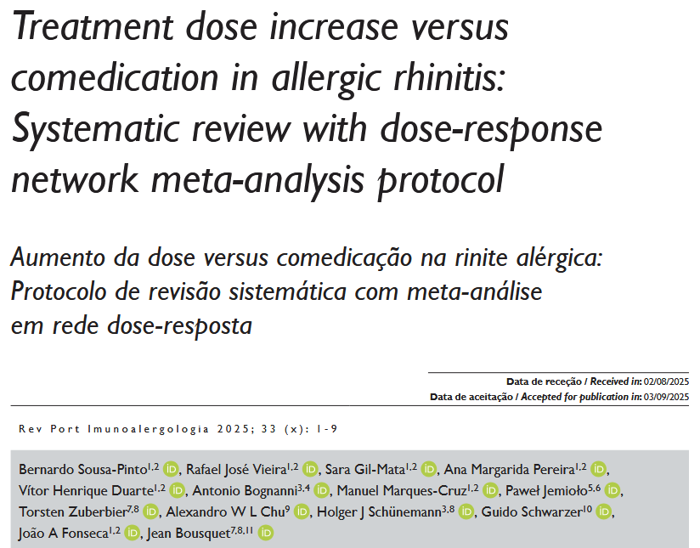
Co-medication vs dose increase medication

Slide 7
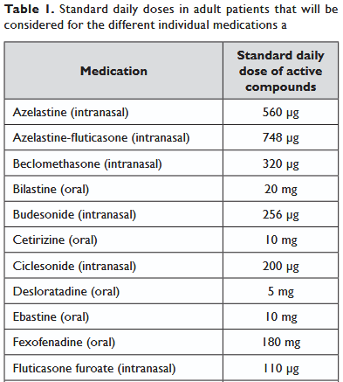
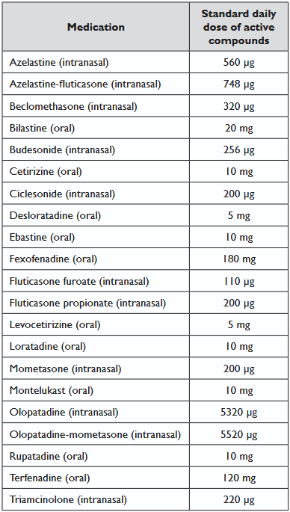
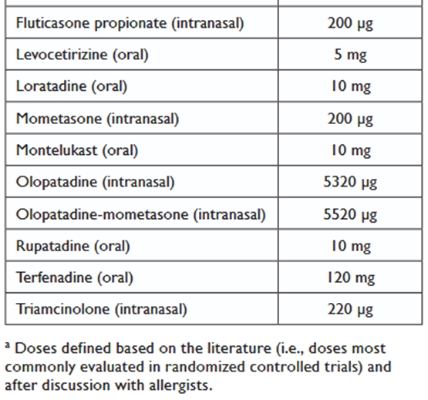
Co-medication vs dose increase medication
vs
+
2x

Slide 8
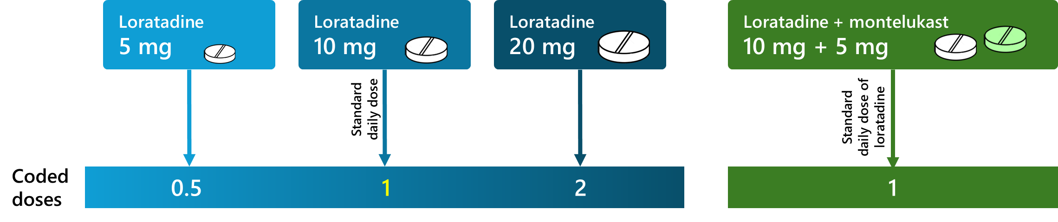
Co-medication vs dose increase medication

Slide 9



Co-medication vs dose increase medication
TNSS
>
OAH
TNSS
=
OAH
RQLQ

Slide 10

Co-medication vs dose increase medication
TNSS
=
TOSS
RQLQ
TNSS
>
For TOSS trivial differences
RQLQ

Slide 11

Co-medication vs dose increase medication
TNSS
>
RQLQ
OAH
OAH
OAH
TNSS
?
TOSS
OAH
LTRA
OAH
OAH
RQLQ

Slide 12
Co-medication vs dose increase medication
Safety
Trivial differences: Doubling the dose of medication versus adding co-medication
  Exceptions: Doubling the dose of montelukast is worse than adding bilastine; doubling the dose of levocetirizine is worse than adding ciclesonide.

Slide 13
3. Should continuous long-term/chronic treatment vs. as-needed treatment be used in patients with allergic rhinitis?
ARIA 2024-2025 guidelines: Person-centred, evidence-based, digitally-enabled, artificial intelligence enabled guidelines;
Development of guideline questions for ARIA 2024-2025;
  Use of large language models to support the generation of guideline questions.
Use of multiple sources of evidence in ARIA 2024-2025.

Slide 14
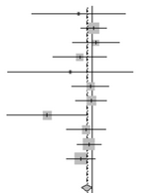


Continuous versus as-needed treatment
Evidence to Decision framework
Desirable effects
Undesirable effects
Certainty of evidence (CoE)
Values
Resources required
Cost-effectiveness
Acceptability
Planetary health
Equity
Priority
Balance of effects
CoE of required resources
Systematic review
Survey to experts
Information on planetary health

Slide 15
Continuous versus as-needed treatment
Evidence to Decision framework
Desirable effects
Undesirable effects
Certainty of evidence (CoE)
Values
Resources required
Cost-effectiveness
Acceptability
Planetary health
Equity
Priority
Balance of effects
CoE of required resources
Systematic review
  Protocol submitted
  Search completed
  Screening stage

Slide 16
Continuous versus as-needed treatment
Evidence to Decision framework
  Favours as-needed treatment (lower resources)
  Impact to be modelled
Desirable effects
Undesirable effects
Certainty of evidence (CoE)
Values
Resources required
Cost-effectiveness
Acceptability
Planetary health
Equity
Priority
Balance of effects
CoE of required resources
Survey to experts
Information on planetary health

Slide 17
Continuous versus as-needed treatment
Evidence to Decision framework
  MASK-air data to evaluate if patients can achieve a good disease control with as-needed treatment
Desirable effects
Undesirable effects
Certainty of evidence (CoE)
Values
Resources required
Cost-effectiveness
Acceptability
Planetary health
Equity
Priority
Balance of effects
CoE of required resources

Slide 18
4. Oral antihistamines + intranasal corticosteroids vs oral antihistamines or intranasal corticosteroids alone?
ARIA 2024-2025 guidelines: Person-centred, evidence-based, digitally-enabled, artificial intelligence enabled guidelines;
Development of guideline questions for ARIA 2024-2025;
  Use of large language models to support the generation of guideline questions.
Use of multiple sources of evidence in ARIA 2024-2025.

Slide 19
Should OAH + INCS vs. INCS alone be used for the treatment of allergic rhinitis?
Recommendation: Conditional recommendation for OAH + INCS
Certainty of evidence: Low
PROVISIONAL
Desirable effects
Undesirable effects
Acceptability
Favours OAH + INCS (small difference)
Trivial differences
Adherence: Favours INCS alone
Treatment satisfaction: Favours INCS alone
Balance of effects
In favour of OAH + INCS

Slide 20
Should OAH + INCS vs. OAH alone be used for the treatment of allergic rhinitis?
Recommendation: Conditional recommendation for OAH + INCS
Certainty of evidence: Low
PROVISIONAL
Desirable effects
Undesirable effects
Acceptability
Favours OAH + INCS (moderate difference)
Trivial differences
Adherence: Favours INCS alone
Treatment satisfaction: Favours INCS alone
Balance of effects
In favour of OAH + INCS

Slide 21
ARIA 2024-2025: Co-medication and as-needed medication
Bernardo Sousa Pinto
(bernardo@med.up.pt)
2025 Dec, 8-11

